Slide 1

Flink internals
Kostas Tzoumas
Flink committer &
Co-founder, data Artisans
ktzoumas@apache.org
@kostas_tzoumas

Slide 2
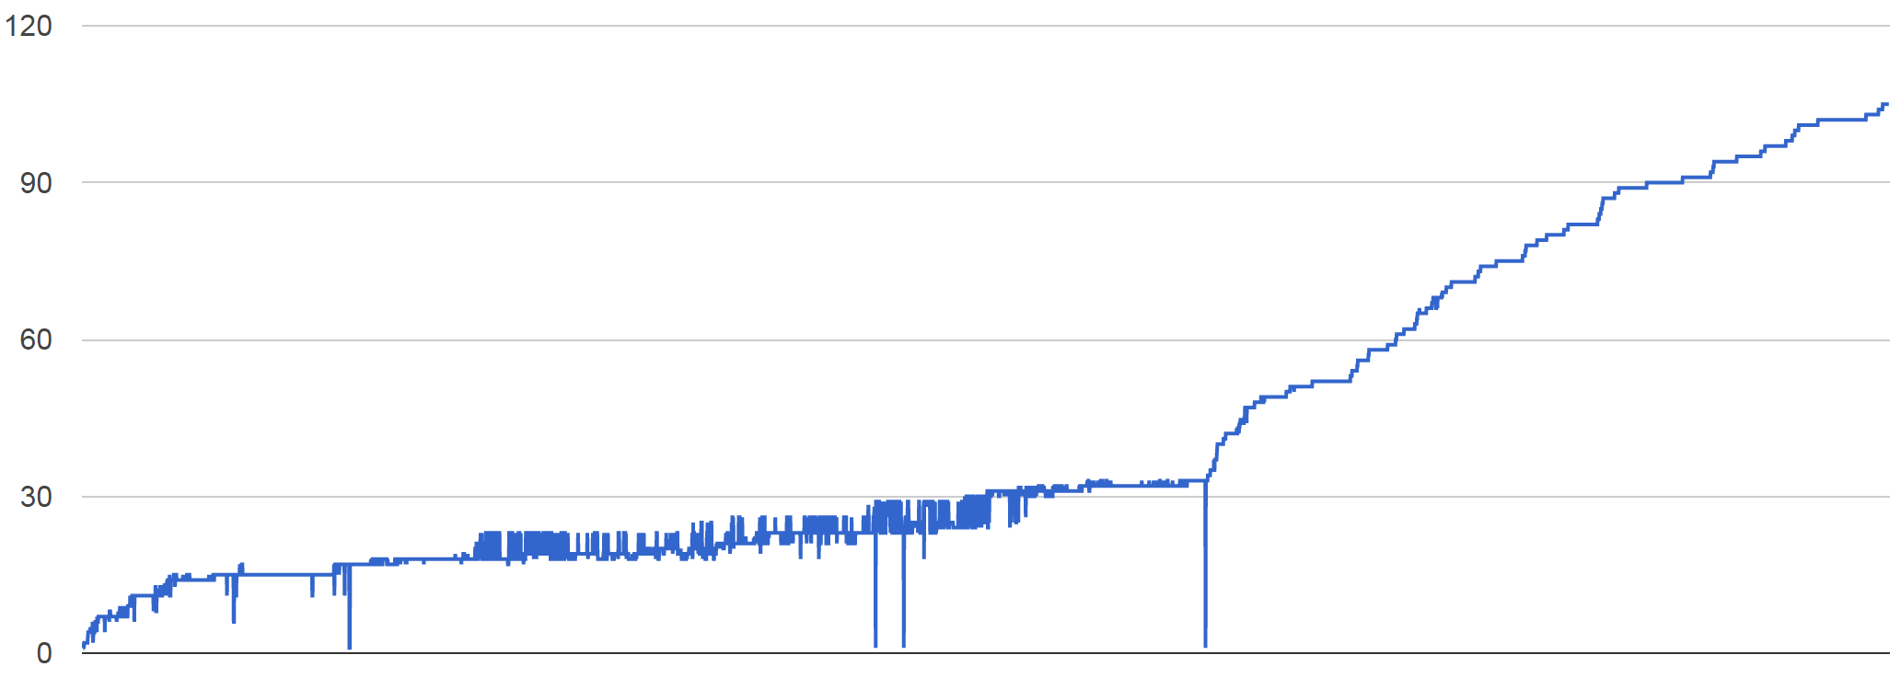
Welcome
Last talk: how to program PageRank in Flink, and Flink programming model
This talk: how Flink works internally
Again, a big bravo to the Flink community

Slide 3

Recap:
Using Flink

Slide 4
DataSet and transformations
Input
X
First
Y
Second
Operator X
Operator Y
ExecutionEnvironment env =
ExecutionEnvironment.getExecutionEnvironment();
DataSet<String> input = env.readTextFile(input);
DataSet<String> first = input
.filter (str -> str.contains(“Apache Flink“));
DataSet<String> second = first
.filter (str -> str.length() > 40);
second.print()
env.execute();

Slide 5
Available transformations
map
flatMap
filter
reduce
reduceGroup
join
coGroup
aggregate
cross
project
distinct
union
iterate
iterateDelta
repartition
…

Slide 6
Other API elements & tools
Accumulators and counters
Int, Long, Double counters
Histogram accumulator
Define your own
Broadcast variables
Plan visualization
Local debugging/testing mode

Slide 7
Data types and grouping
public static class Access {
public int userId;
public String url;
...
}
public static class User {
public int userId;
public int region;
public Date customerSince;
...
}
DataSet<Tuple2<Access,User>> campaign = access.join(users)
.where(“userId“).equalTo(“userId“)
DataSet<Tuple3<Integer,String,String> someLog;
someLog.groupBy(0,1).reduceGroup(...);
Bean-style Java classes & field names
Tuples and position addressing
Any data type with key selector function

Slide 8
Other API elements
Hadoop compatibility
Supports all Hadoop data types, input/output formats, Hadoop mappers and reducers
Data streaming API
DataStream instead of DataSet
Similar set of operators
Currently in alpha but moving very fast
Scala and Java APIs (mirrored)
Graph API (Spargel)

Slide 9
Intro to internals

Slide 10

DataSet<String> text = env.readTextFile(input);
DataSet<Tuple2<String, Integer>> result = text
.flatMap((str, out) -> {
for (String token : value.split("\\W")) {
out.collect(new Tuple2<>(token, 1));
})
.groupBy(0)
.aggregate(SUM, 1);
O, 1
Romeo, 3
wherefore, 1
art, 1
thou, 1
Task Manager
O Romeo, Romeo, wherefore art thou Romeo?
Flink Client & Optimizer
Job Manager
nor, 3
arm, 1
face, 1,
any, 1,
other, 1
part, 1
Task Manager
Nor arm, nor face, nor any other part
Apache Flink

Slide 11
If you want to know one thing about Flink is that you don’t need to know the internals of Flink.

Slide 12
Philosophy
Flink “hides” its internal workings from the user
This is good
User does not worry about how jobs are executed
Internals can be changed without breaking changes
… and bad
Execution model more complicated to explain compared to MapReduce or Spark RDD

Slide 13
Recap: DataSet
Input
X
First
Y
Second
Operator X
Operator Y
ExecutionEnvironment env =
ExecutionEnvironment.getExecutionEnvironment();
DataSet<String> input = env.readTextFile(input);
DataSet<String> first = input
.filter (str -> str.contains(“Apache Flink“));
DataSet<String> second = first
.filter (str -> str.length() > 40);
second.print()
env.execute();

Slide 14
Common misconception
Input
X
First
Y
Second
Programs are not executed eagerly
Instead, system compiles program to an execution plan and executes that plan

Slide 15
DataSet<String>
Think of it as a PCollection<String>, or a Spark RDD[String]
With a major difference: it can be produced/recovered in several ways
… like a Java collection
… like an RDD
… perhaps it is never fully materialized (because the program does not need it to)
… implicitly updated in an iteration
And this is transparent to the user

Slide 16
Example: grep
Search for str1
Grep 1
Romeo, Romeo, where art thou Romeo?
Load
Log
Search for str2
Grep 2
Search for str2
Grep 2

Slide 17


Staged (batch) execution
Subseqent stages:
Grep log for matches
Stage 1:
Create/cache Log
Search for str1
Grep 1
Romeo, Romeo, where art thou Romeo?
Load
Log
Search for str2
Grep 2
Search for str2
Grep 2
Caching in-memory and disk if needed

Slide 18
Pipelined execution
Stage 1:
Deploy and start operators
Note: Log DataSet is never “created”!
Search for str1
Grep 1
Romeo, Romeo, where art thou Romeo?
00110011
00110011
00110011
Load
Log
Search for str2
Grep 2
Search for str2
Grep 2
Data transfer in-memory and disk if needed

Slide 19
Benefits of pipelining
25 node cluster
Grep log for 3 terms
Scale data size from 100GB to 1TB
Time to complete grep (sec)
Staged execution with Spark
Pipelined with Flink
Cluster memory
exceeded
Data size (GB)

Slide 20
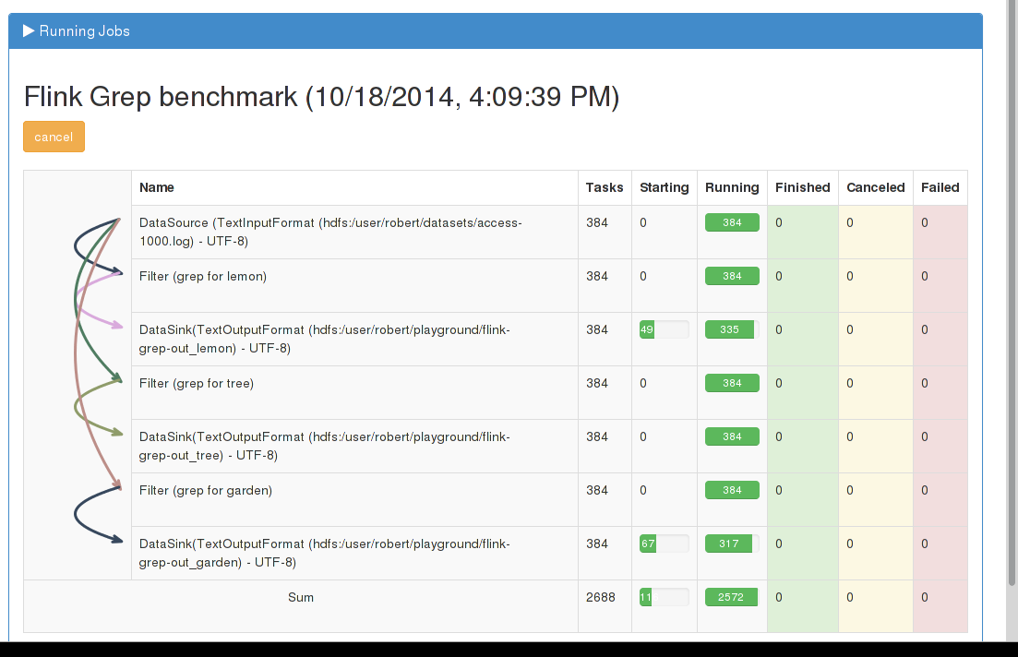

Slide 21
Drawbacks of pipelining
Long pipelines may be active at the same time leading to memory fragmentation
FLINK-1101: Changes memory allocation from static to adaptive
Fault-tolerance harder to get right
FLINK-986: Adds intermediate data sets (similar to RDDS) as first-class citizen to Flink Runtime. Will lead to fine-grained fault-tolerance among other features.

Slide 22
Example: Iterative processing
DataSet<Page> pages = ...
DataSet<Neighborhood> edges = ...
DataSet<Page> oldRanks = pages; DataSet<Page> newRanks;
for (i = 0; i < maxIterations; i++) {
newRanks = update(oldRanks, edges)
oldRanks = newRanks
}
DataSet<Page> result = newRanks;
DataSet<Page> update (DataSet<Page> ranks, DataSet<Neighborhood> adjacency) {
return oldRanks
.join(adjacency)
.where(“id“).equalTo(“id“)
.with ( (page, adj, out) -> {
for (long n : adj.neighbors)
out.collect(new Page(n, df * page.rank / adj.neighbors.length))
})
.groupBy(“id“)
.reduce ( (a, b) -> new Page(a.id, a.rank + b.rank) );

Slide 23



Iterate by unrolling
Client
Step
Step
Step
Step
Step
for/while loop in client submits one job per iteration step
Data reuse by caching in memory and/or disk

Slide 24
Iterate natively
DataSet<Page> pages = ...
DataSet<Neighborhood> edges = ...
IterativeDataSet<Page> pagesIter = pages.iterate(maxIterations);
DataSet<Page> newRanks = update (pagesIter, edges);
DataSet<Page> result = pagesIter.closeWith(newRanks)

Slide 25
Iterate natively with deltas
DeltaIteration<...> pagesIter = pages.iterateDelta(initialDeltas, maxIterations, 0);
DataSet<...> newRanks = update (pagesIter, edges);
DataSet<...> newRanks = ...
DataSet<...> result = pagesIter.closeWith(newRanks, deltas)
See http://data-artisans.com/data-analysis-with-flink.html

Slide 26
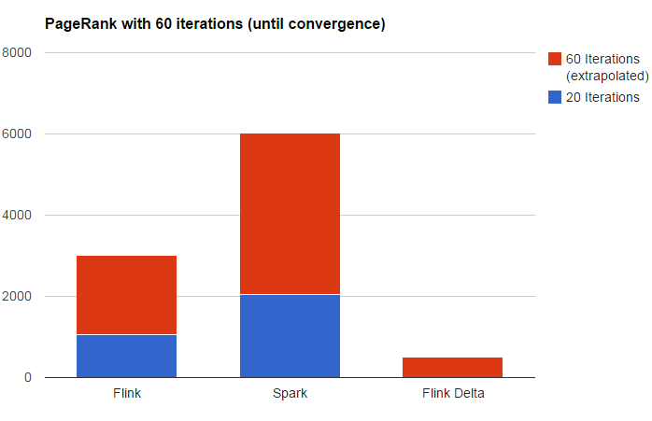
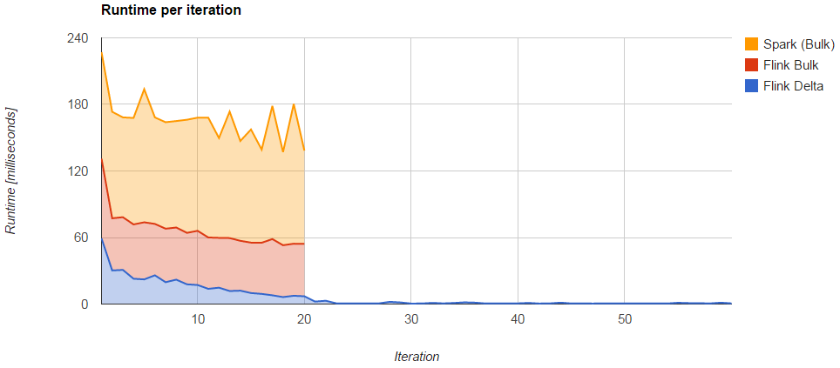
Native, unrolling, and delta

Slide 27
Dissecting
Flink

Slide 28


Slide 29
Flink stack
Python API
(upcoming)
Graph API
Apache
MRQL
Scala API
(batch)
Java API
(streaming)
Java API
(batch)
Common API
Flink Optimizer
Flink Stream Builder
Apache Tez
Embedded execution
(Java collections)
Flink Runtime
YARN
EC2
Local execution
Flink Execution Engine
Data
storage
Files
HDFS
S3
JDBC
Azure
tables
Kafka
Rabbit MQ
Redis
…

Slide 30
Flink stack
Python API
(upcoming)
Graph API
Apache
MRQL
Scala API
(batch)
Java API
(streaming)
Java API
(batch)
Common API
Flink Optimizer
Flink Stream Builder
Flink Local Runtime
Embedded
environment
(Java collections)
Local
Environment
(for debugging)
Remote environment
(Regular cluster execution)
Apache Tez
Single node execution
Flink cluster
YARN
Data
storage
Files
HDFS
S3
JDBC
Azure
tables
Kafka
Rabbit MQ
Redis
…

Slide 31
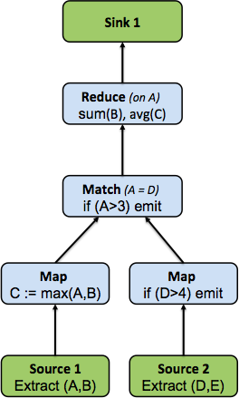
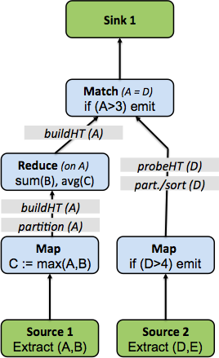
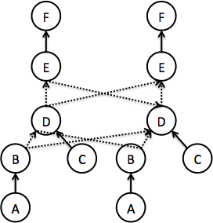
Program lifecycle
val source1 = …
val source2 = …
val maxed = source1
.map(v => (v._1,v._2,
math.max(v._1,v._2))
val filtered = source2
.filter(v => (v._1 > 4))
val result = maxed
.join(filtered).where(0).equalTo(0)
.filter(_1 > 3)
.groupBy(0)
.reduceGroup {……}
1

Slide 32
Flink Optimizer
The optimizer is the component that selects an execution plan for a Common API program
Think of an AI system manipulating your program for you ☺
But don’t be scared – it works
Relational databases have been doing this for decades – Flink ports the technology to API-based systems

Slide 33
A simple program
DataSet<Tuple5<Integer, String, String, String, Integer>> orders = …
DataSet<Tuple2<Integer, Double>> lineitems = … DataSet<Tuple2<Integer, Integer>> filteredOrders = orders
.filter(. . .)
.project(0,4).types(Integer.class, Integer.class); DataSet<Tuple3<Integer, Integer, Double>> lineitemsOfOrders = filteredOrders
.join(lineitems) .where(0).equalTo(0) .projectFirst(0,1).projectSecond(1) .types(Integer.class, Integer.class, Double.class); DataSet<Tuple3<Integer, Integer, Double>> priceSums = lineitemsOfOrders
.groupBy(0,1).aggregate(Aggregations.SUM, 2); priceSums.writeAsCsv(outputPath);

Slide 34
Two execution plans
GroupRed
GroupRed
sort
sort
hash-part [0,1]
Combine
Best plan
depends on
relative sizes of input files
forward
Join
Hybrid Hash
Join
Hybrid Hash
buildHT
probe
buildHT
probe
broadcast
forward
hash-part [0]
hash-part [0]
Map
DataSource
lineitem.tbl
Map
DataSource
lineitem.tbl
Filter
Filter
DataSource
orders.tbl
DataSource
orders.tbl

Slide 35
Flink Local Runtime
Local runtime, not the distributed execution engine
Aka: what happens inside every parallel task

Slide 36
Flink runtime operators
Sorting and hashing data
Necessary for grouping, aggregation, reduce, join, cogroup, delta iterations
Flink contains tailored implementations of hybrid hashing and external sorting in Java
Scale well with both abundant and restricted memory sizes

Slide 37
Internal data representation
How is intermediate data internally represented?
JVM Heap
JVM Heap
reduce
O Romeo, Romeo, wherefore art thou Romeo?
map
art, 1
O, 1
Romeo, 1
Romeo, 1
Local sort
00110011
00010111
01110001
01111010
00010111
00110011
00110011
Network transfer

Slide 38
Internal data representation
Two options: Java objects or raw bytes
Java objects
Easier to program
Can suffer from GC overhead
Hard to de-stage data to disk, may suffer from “out of memory exceptions”
Raw bytes
Harder to program (customer serialization stack, more involved runtime operators)
Solves most of memory and GC problems
Overhead from object (de)serialization
Flink follows the raw byte approach

Slide 39
Memory in Flink
JVM Heap
User code objects
Unmanaged
heap
public class WC {
public String word;
public int count;
}
Sorting, hashing, caching
Managed
heap
empty
page
Network
buffers
Shuffling, broadcasts
Pool of Memory Pages

Slide 40
Memory in Flink (2)
Internal memory management
Flink initially allocates 70% of the free heap as byte[] segments
Internal operators allocate() and release() these segments
Flink has its own serialization stack
All accepted data types serialized to data segments
Easy to reason about memory, (almost) no OutOfMemory errors, reduces the pressure to the GC (smooth performance)

Slide 41
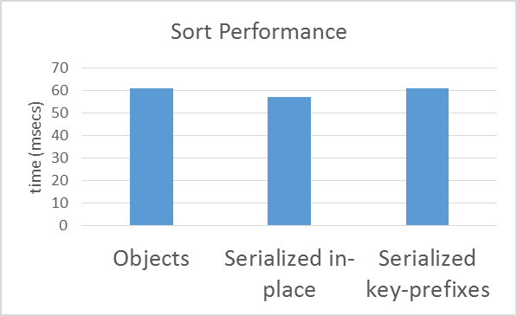
Operating on serialized data
Microbenchmark
Sorting 1GB worth of (long, double) tuples
67,108,864 elements
Simple quicksort

Slide 42
Flink Execution Engine
The distributed execution engine
Pipelined
Same engine for Flink and Flink streaming
Pluggable
Local runtime can be executed on other engines
E.g., Java collections and Apache Tez

Slide 43
Closing

Slide 44
Summary
Flink decouples API from execution
Same program can be executed in many different ways
Hopefully users do not need to care about this and still get very good performance
Unique Flink internal features
Pipelined execution, native iterations, optimizer, serialized data manipulation, good disk destaging
Very good performance
Known issues currently worked on actively

Slide 45
Stay informed
flink.incubator.apache.org
Subscribe to the mailing lists!
http://flink.incubator.apache.org/community.html#mailing-lists
Blogs
flink.incubator.apache.org/blog
data-artisans.com/blog
Twitter
follow @ApacheFlink

Slide 46



Slide 47

That’s it, time for beer

Slide 48
Appendix

Slide 49





Flink in context
Hive
Cascading
Applications
Mahout
Pig
…
MapReduce
Flink
Data processing engines
Spark
Storm
Tez
App and resource management
Yarn
Mesos
HDFS
HBase
Kafka
…
Storage, streams

Slide 50
Common API
Notion of “DataSet” is no longer present
Program is a DAG of operators
DataSource
MapOperator
JoinOperator
DataSink
Operator
DataSource
FilterOperator

Slide 51
Example: Joins in Flink
γ
⋈
⋈
small
DataSet<Order> large = ...
DataSet<Lineitem> medium = ...
DataSet<Customer> small = ...
DataSet<Tuple...> joined1 = large.join(medium).where(3).equals(1)
.with(new JoinFunction() { ... });
DataSet<Tuple...> joined2 = small.join(joined1).where(0).equals(2)
.with(new JoinFunction() { ... });
DataSet<Tuple...> result = joined2.groupBy(3).aggregate(MAX, 2);
large
medium
Built-in strategies include partitioned join and replicated join with
local sort-merge or hybrid-hash algorithms.

Slide 52
Optimizer Example
DataSet<Tuple...> large = env.readCsv(...);
DataSet<Tuple...> medium = env.readCsv(...);
DataSet<Tuple...> small = env.readCsv(...);
DataSet<Tuple...> joined1 = large.join(medium).where(3).equals(1)
.with(new JoinFunction() { ... });
DataSet<Tuple...> joined2 = small.join(joined1).where(0).equals(2)
.with(new JoinFunction() { ... });
DataSet<Tuple...> result = joined2.groupBy(3).aggregate(MAX, 2);
1) Partitioned hash-join
2) Broadcast hash-join
3) Grouping /Aggregation reuses the partitioning from step (1) → No shuffle!!!
Partitioned ≈ Reduce-side
Broadcast ≈ Map-side
Notes:
cool feature: automatic

Slide 53


Operating on serialized data
serializes data every time
→ Highly robust, never gives up on you
works on objects, RDDs may be stored serialized
→Serialization considered slow, only when needed
makes serialization really cheap: → partial deserialization, operates on serialized form → Efficient and robust!

